Slide 1
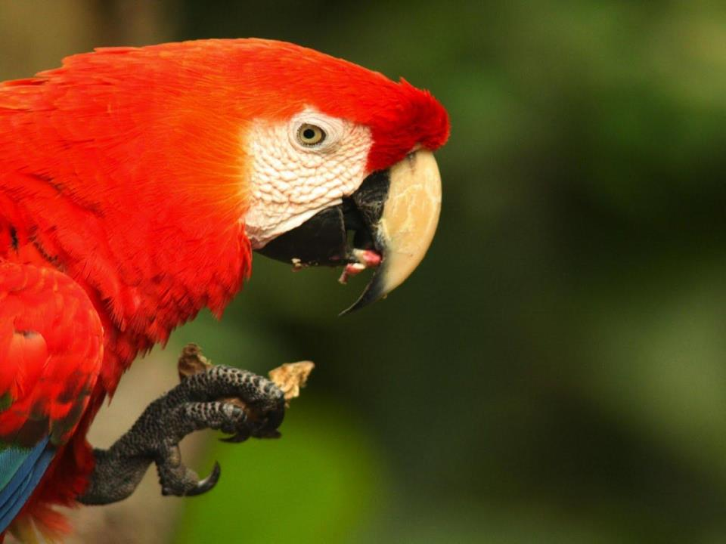

The Maya Forest Corridor

Slide 2
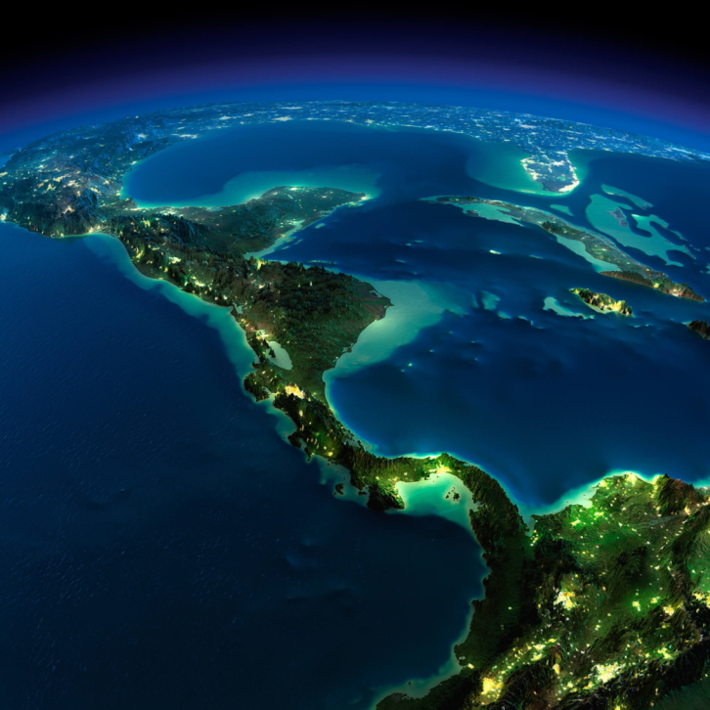
Mesoamerica

Slide 3
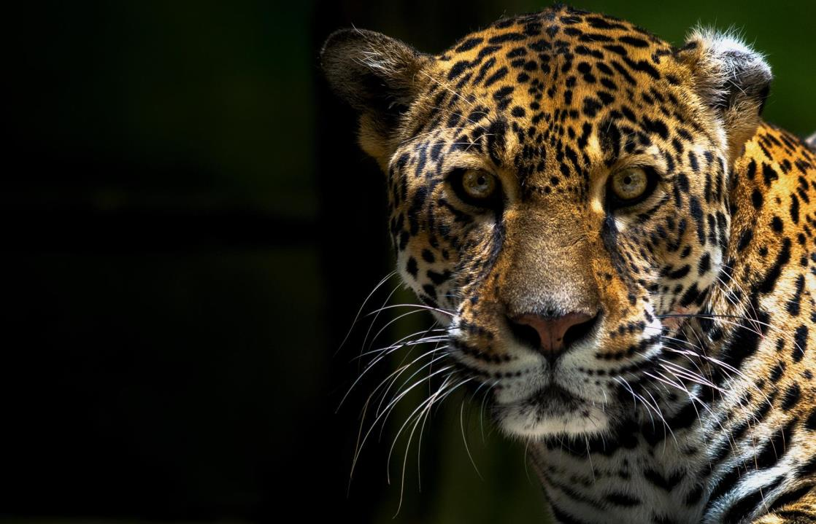

Slide 4
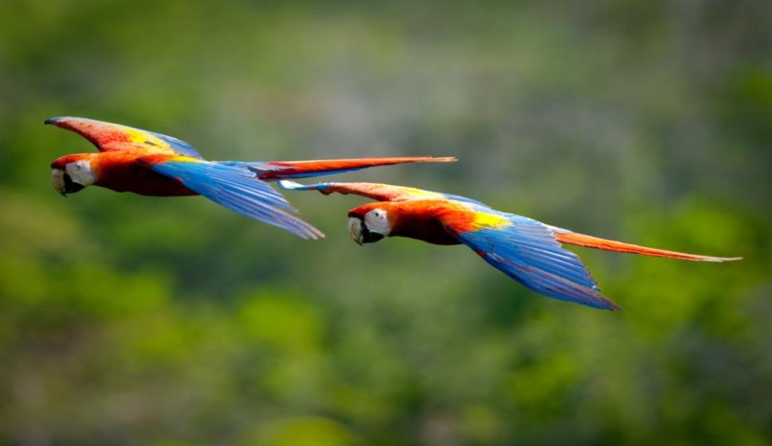
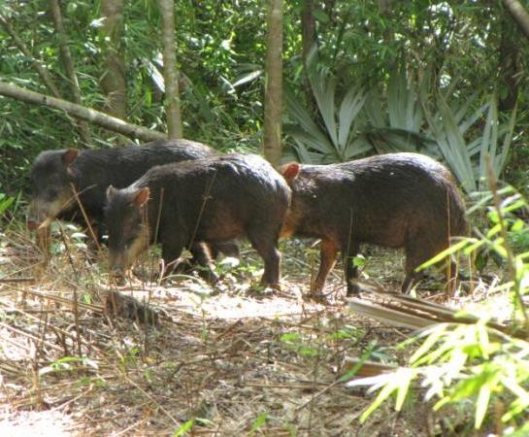
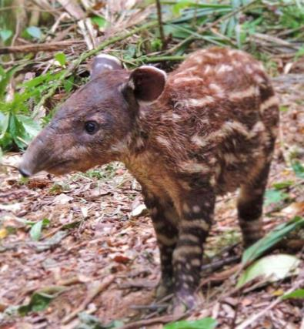

Slide 5
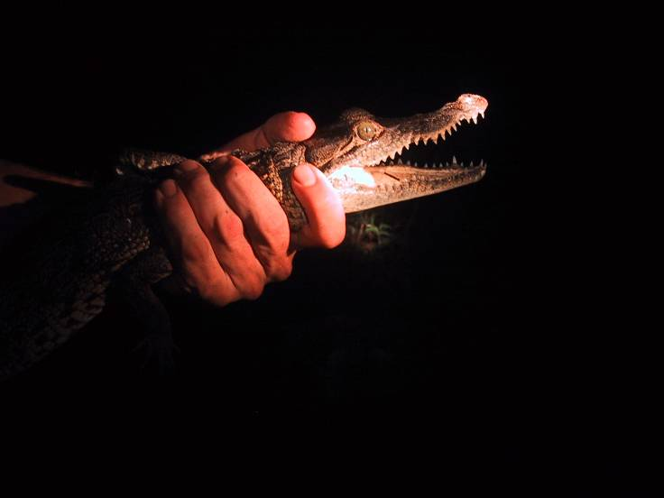
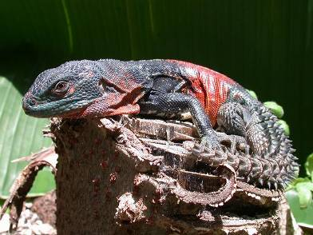
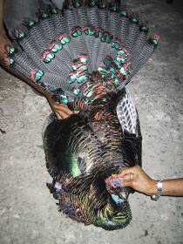
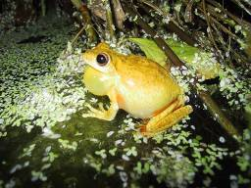
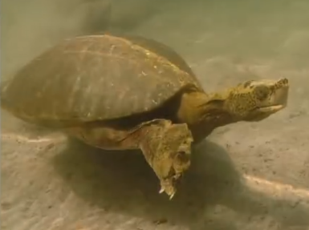

Slide 6
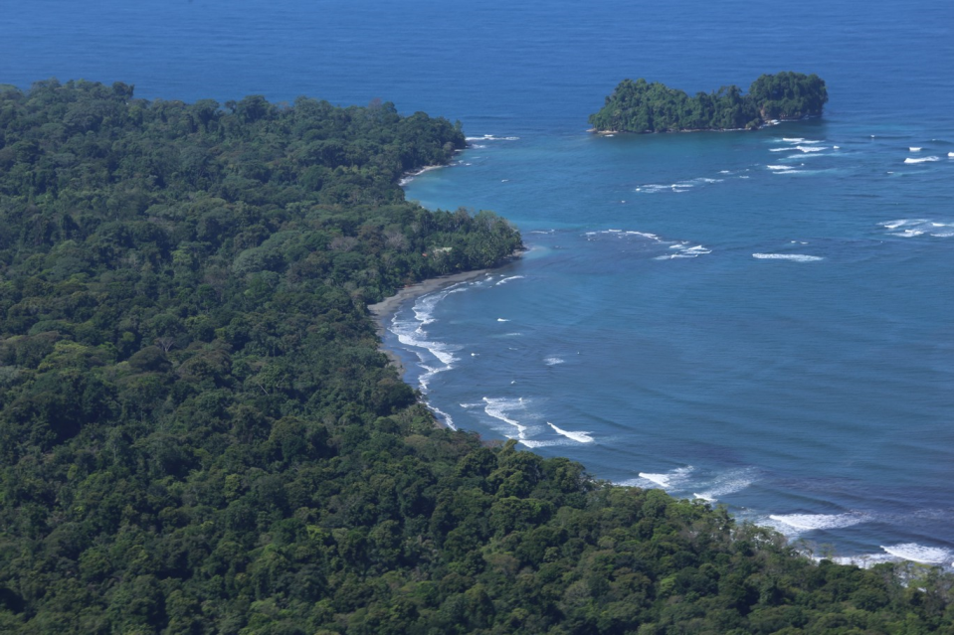

Slide 7
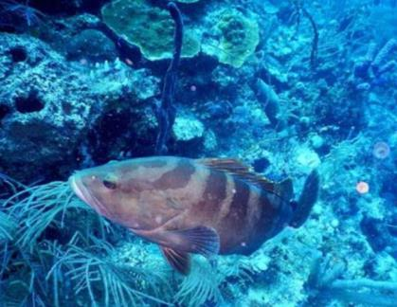
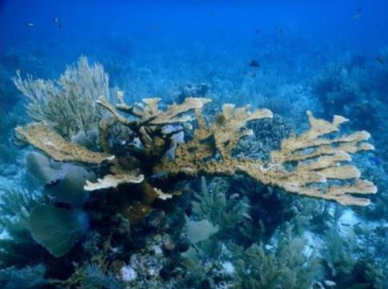
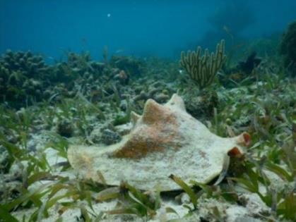

Slide 8
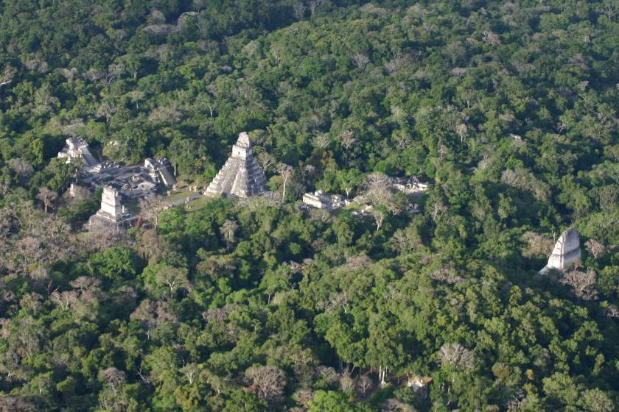

Slide 9
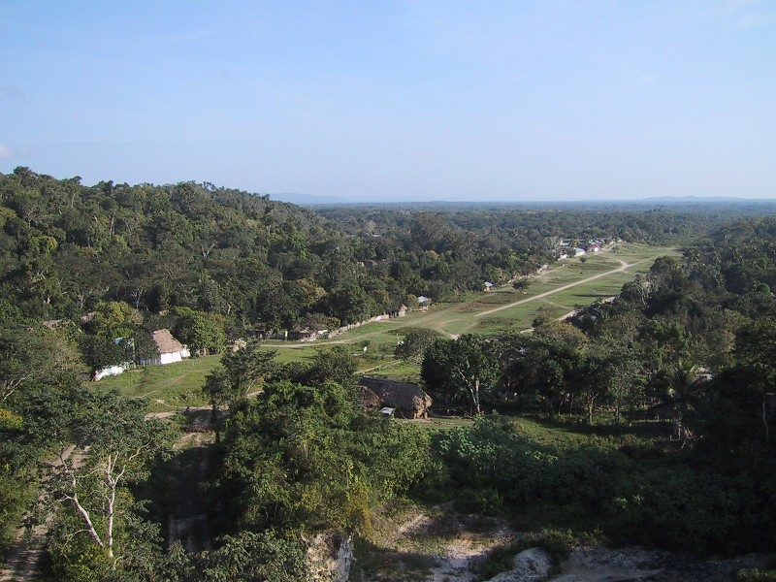

Slide 10
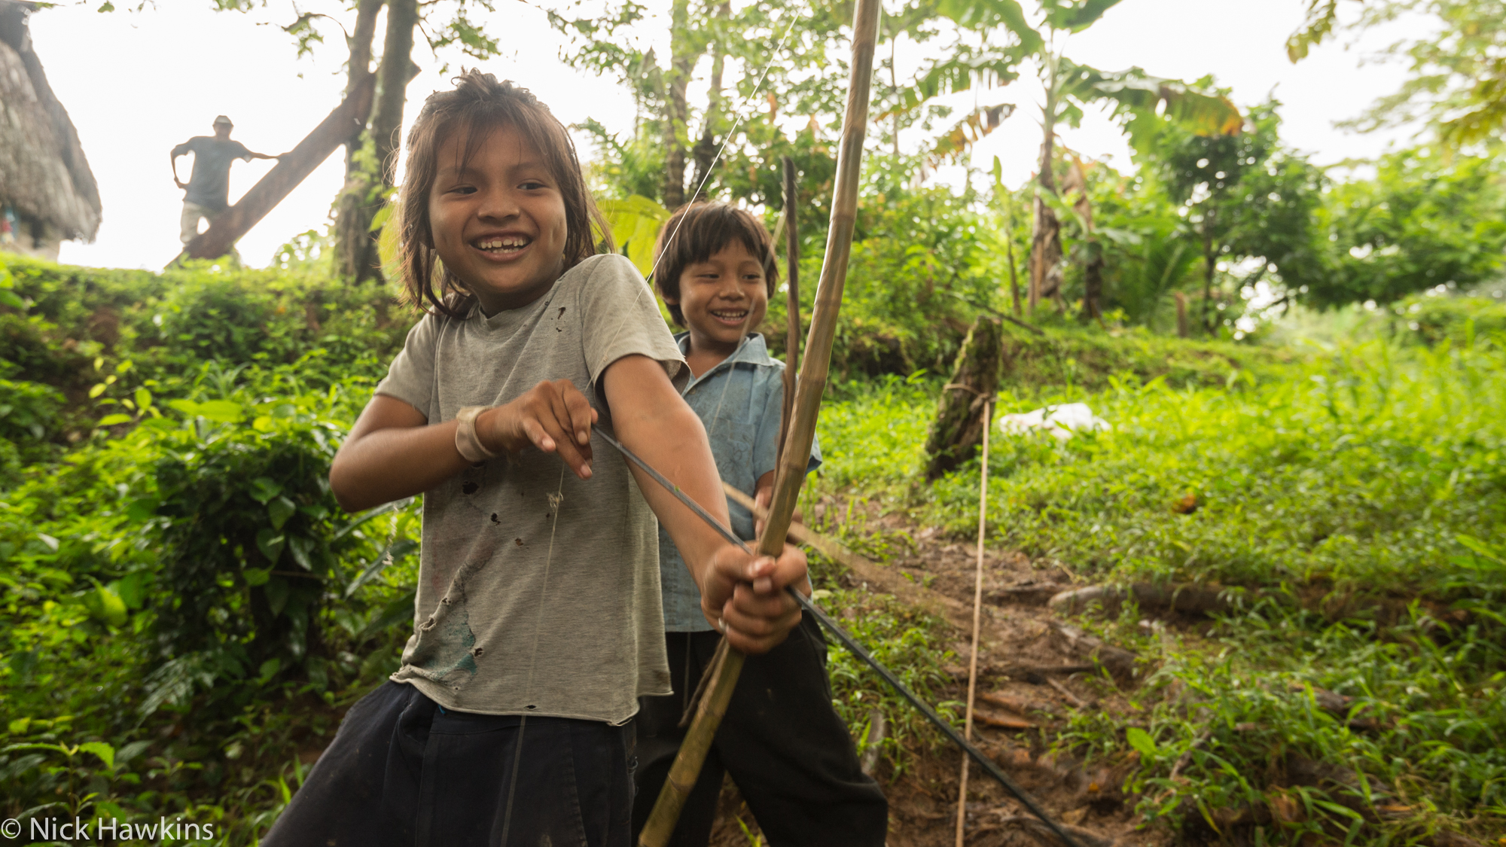
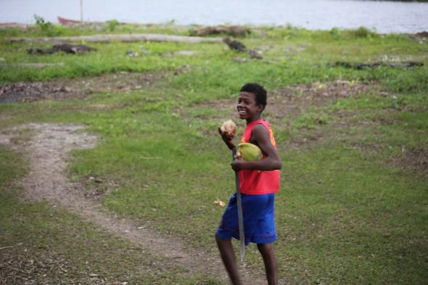
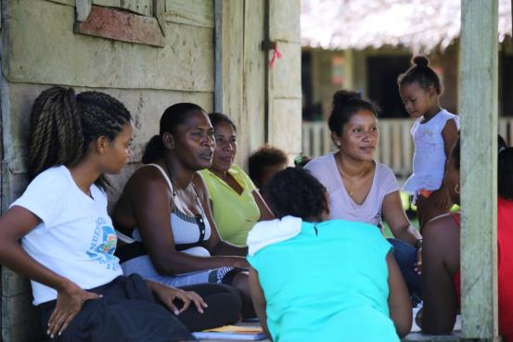

Slide 11
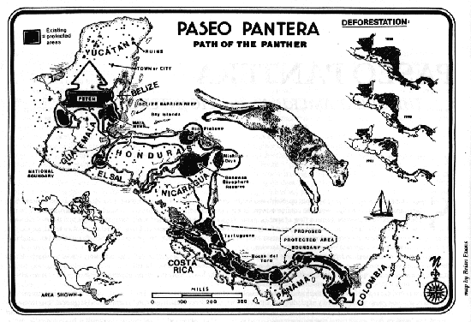
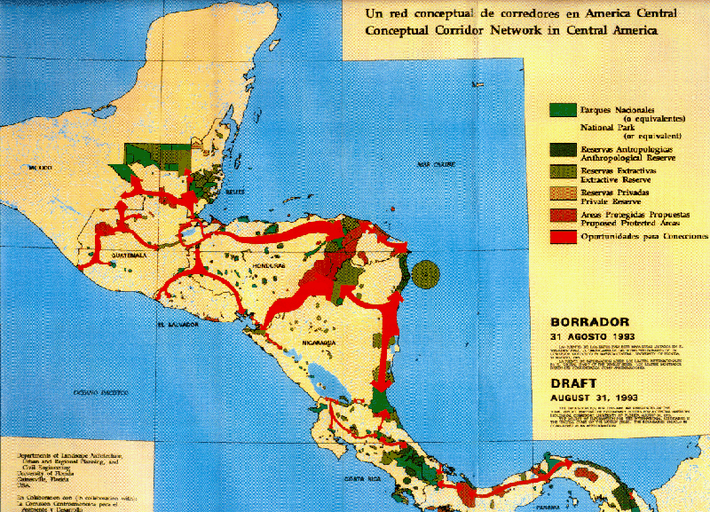
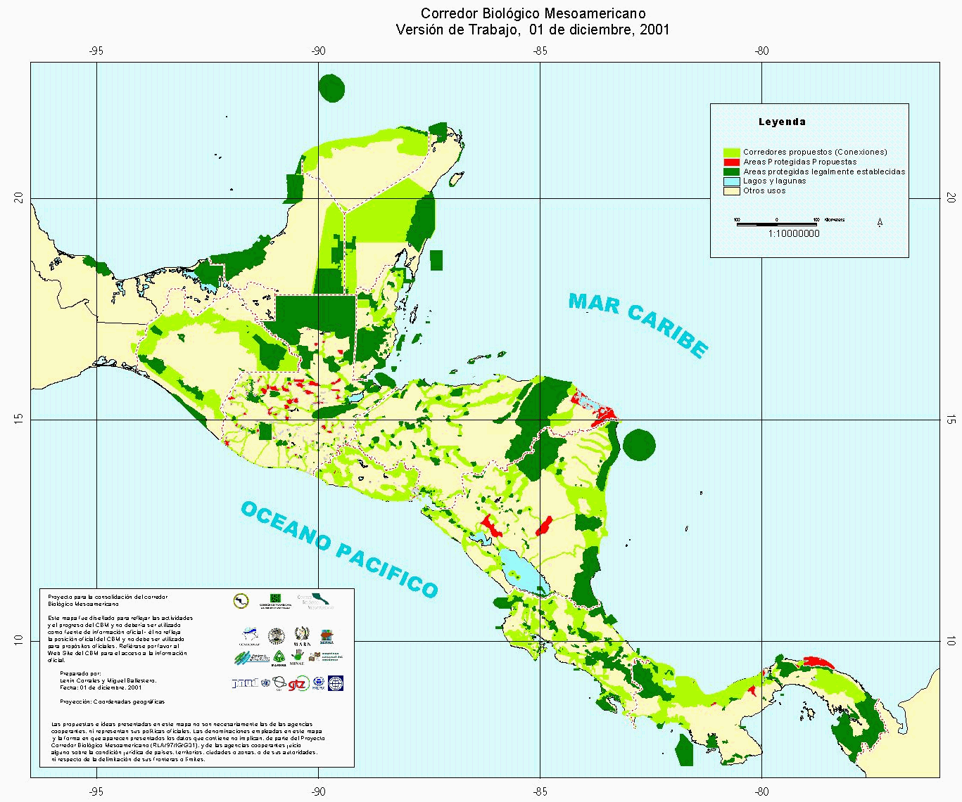

Slide 12
Mesoamerica in Crisis
Notes:
However, enormous threats

Slide 13
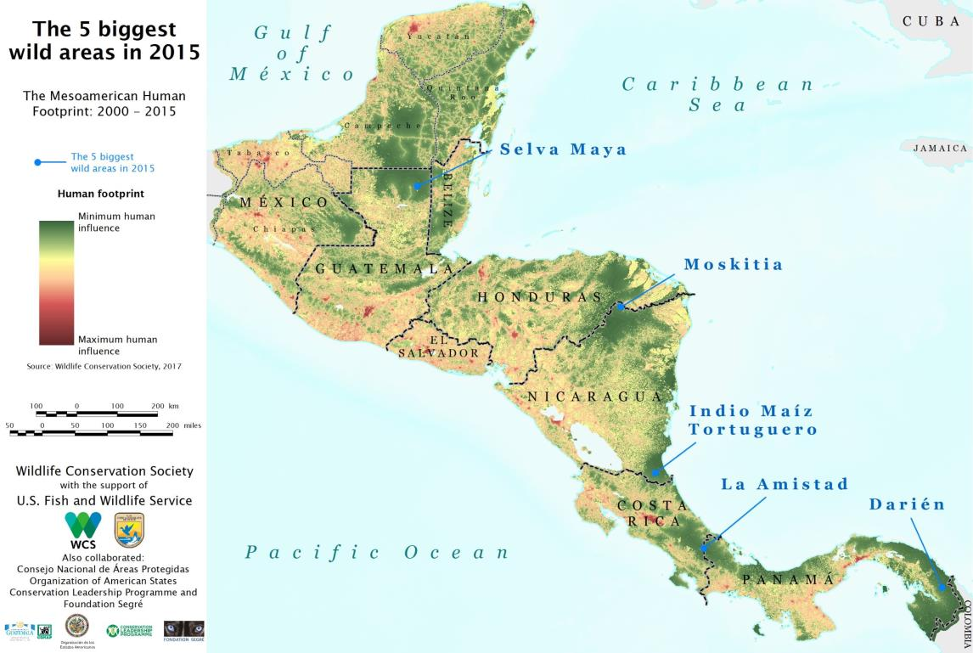
5 Great Forests:
127,783 km2
3 times the size of Switzerland

Slide 14
Reduction in Area
2000-2015
-25%
-30%
-23%
-5%
-5%

Slide 15
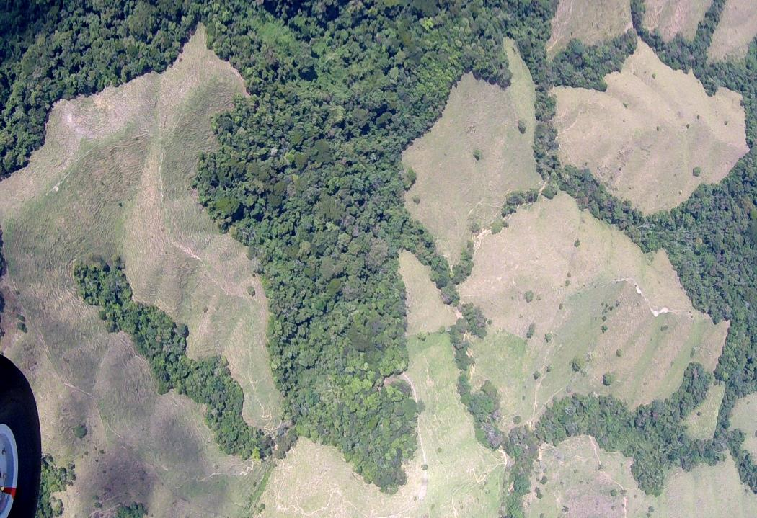
Impacts on forests

Slide 16
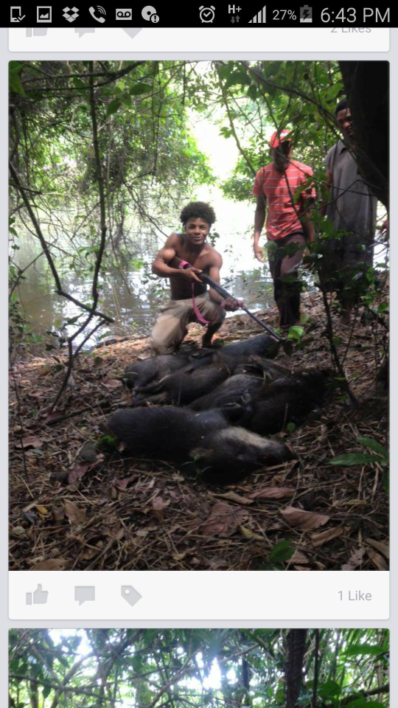

Impacts on wildlife

Slide 17
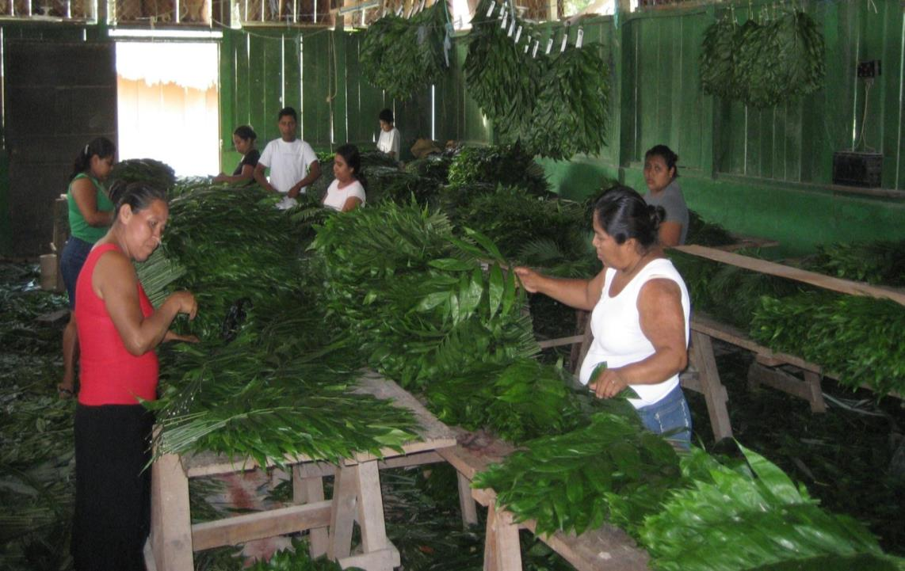
Impacts on local people
Notes:
Tambien impacta a la gente que local solamente quiere vivir una vida digna de forma sostenible, en armonia con los recursos naturales

Slide 18
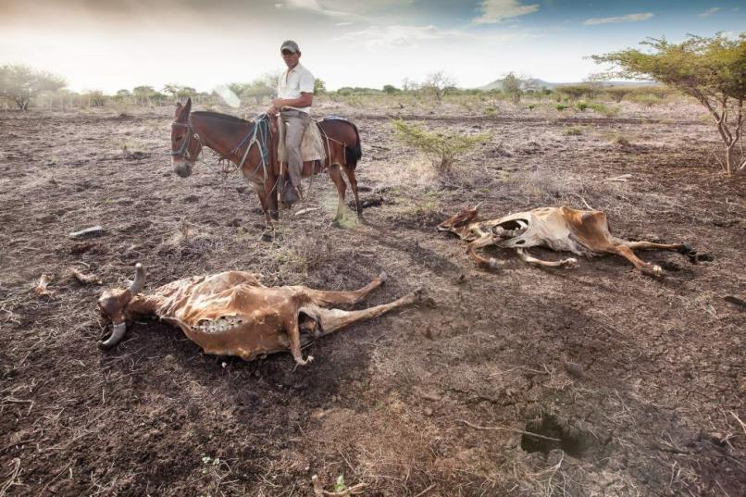
Air, water and climate
Foto: Sean Hawkey
Notes:
Tambien nos roba de los elementos basicos que necesitamos para vivir, como el agua y el aire.
Y exacerba los impactos del cambio climatico – de lo cual Mesoamerica no tiene la culpa, pero esta expuesta

Slide 19
Maya Forest Corridor
Notes:
However, enormous threats

Slide 20

The Maya Forest
4 million ha
= CT + MA
?

Slide 21
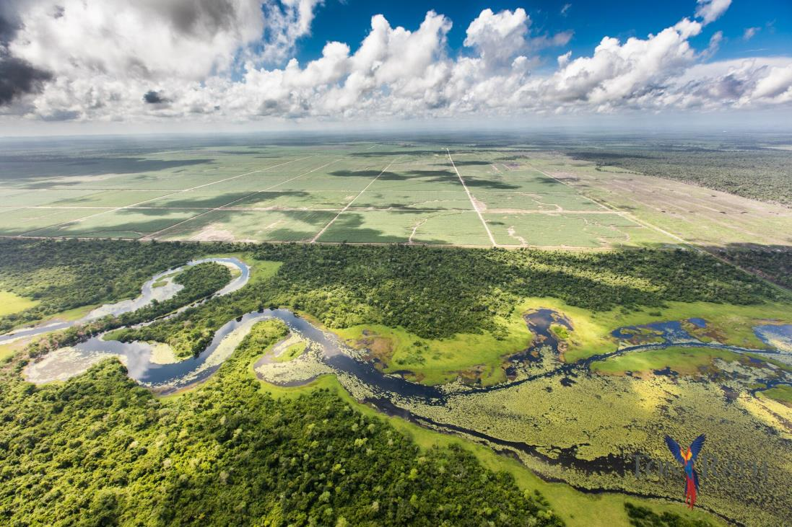
Still in time, but we must act urgently

Slide 22
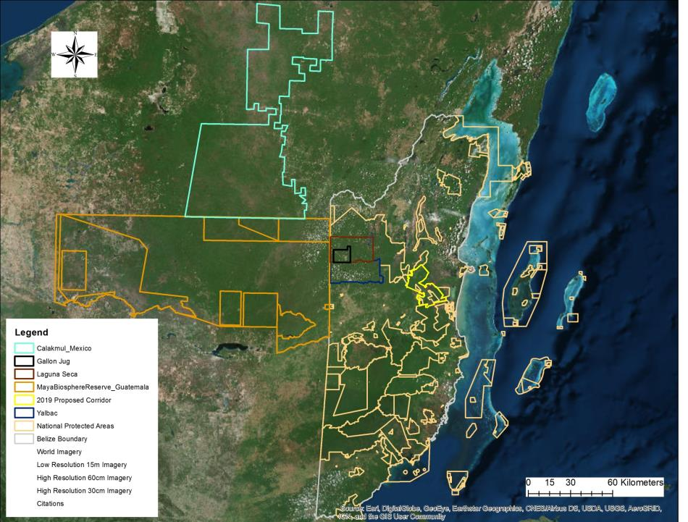
Calakmul Biosphere Reserve
MAYA
FOREST
CORRIDOR
Rio Bravo
SELVA MAYA
Maya Biosphere Reserve
Yalbac
MAYA MOUNTAINS

Slide 24
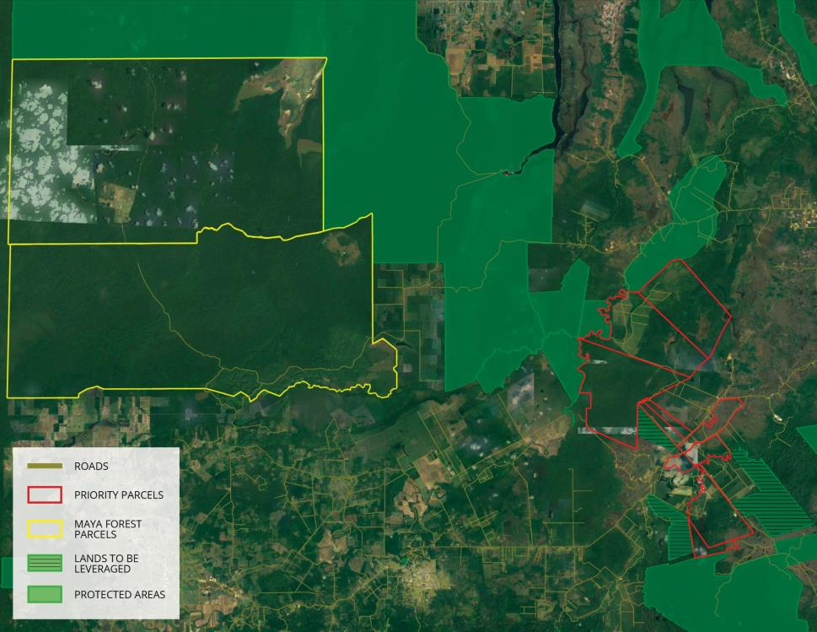

Slide 25
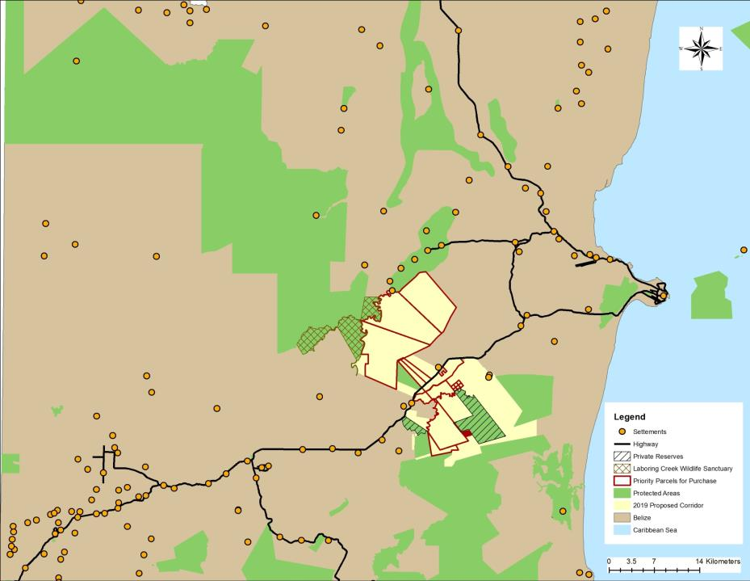
May 2019 cabinet-level resolution stating the government's willingness to gazette the corridor as under the Protected Areas Act.
The Act provides potential for tax exemptions for property holders who put their land into trust, and allows the Ministry to strictly apply all
environmental laws

Slide 26
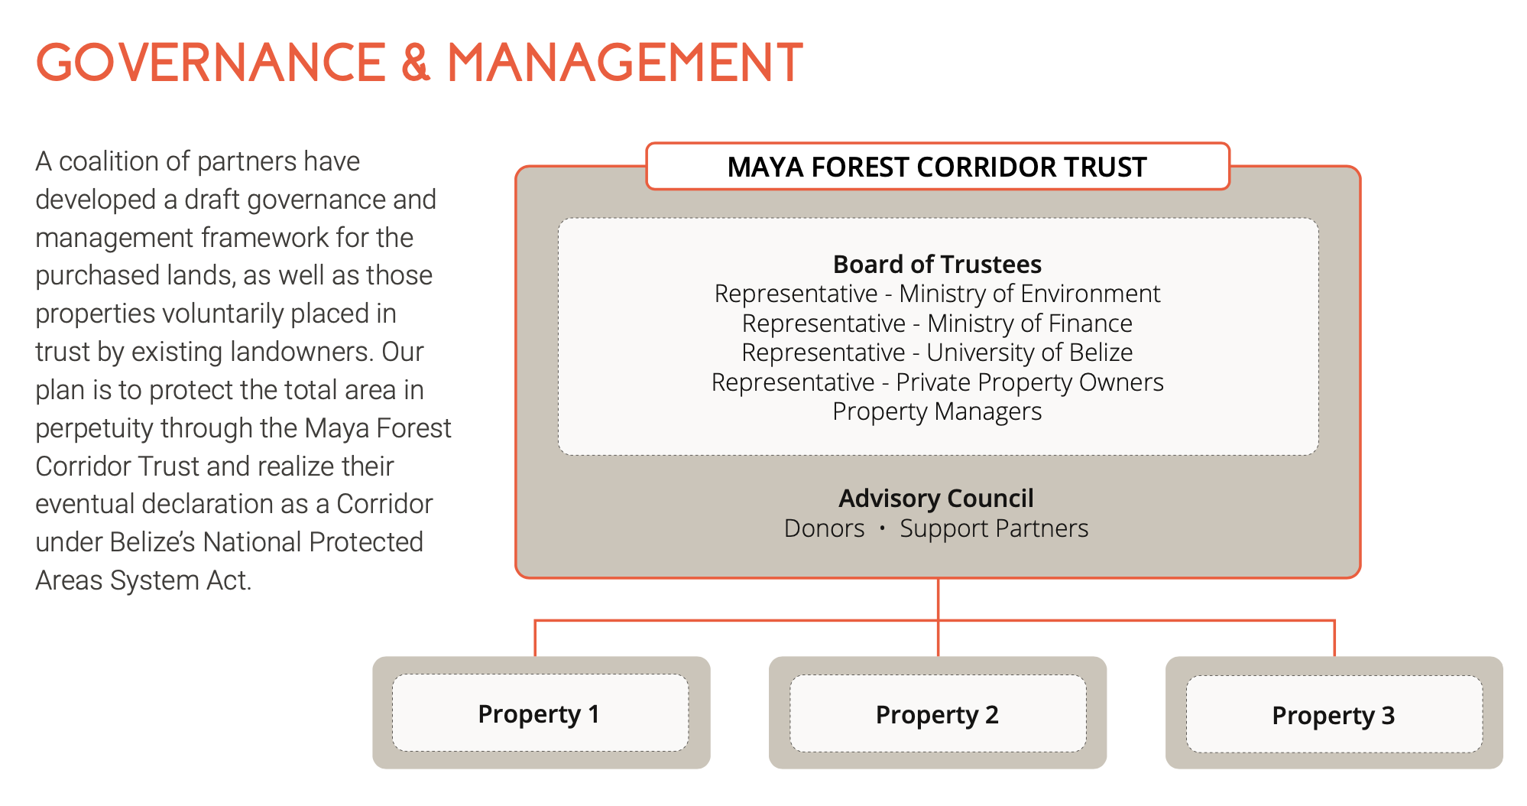

Slide 27
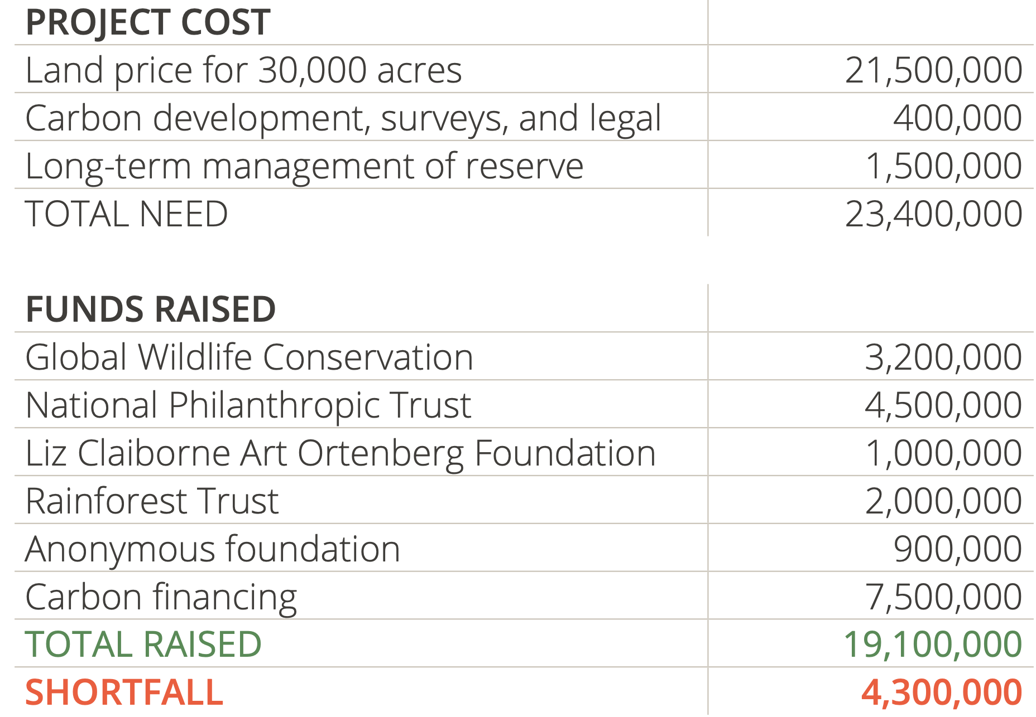
True gap = Approx $2M

